Slide 1

Scaling Real-World Programming with ChatGPT
Morten Heine Sørensen
Formalit
mhs@formalit.dk
ISOLA Type- and Logic-Based Methods for System Specification, Synthesis and Analysis
2024-10-31
Joint work with Mark Hissink Muller

Slide 2
What problem are trying to solve
Generate an application from from a specification of what it should do
OR
Automate the work of the devs on an application in the dev team
OR
Speed up the work of the devs on an application in the dev team

Slide 3
What is an application?
UI
API
BUSINESS LOGIC
DB

Slide 4
What solution are we proposing
To use LLM

Slide 5
ChatGPT then and now – hip or hype?
Phase 1: November 2022, ChatGPT3.5 – Beginnings
Is 2023 a prime?
1s and 1s give 2s
ChatGPT is Santa Claus
Coding with ChatGPT
Phase 2: March 2023, ChatGPT4 – Transition
Plugins
Open the pod bay doors, HAL
Open AI API
Phase 3: Summer 2023 – New era
LinkedIn rumours
Reported experiments
Scaling real-world application development
The dialogues
Is ChatGPT just another tool?
Phase 4: Summer 2024 ChatGPT 4o et al – Removing the limitations
Removing the limitations
Symbolic reasoning
Autonomy of the LLM
Beyond coding
Hip or Hype?
hip or hype?

Slide 6
Phase 1 – November 2022 ChatGPT3.5 Beginnings

Slide 7
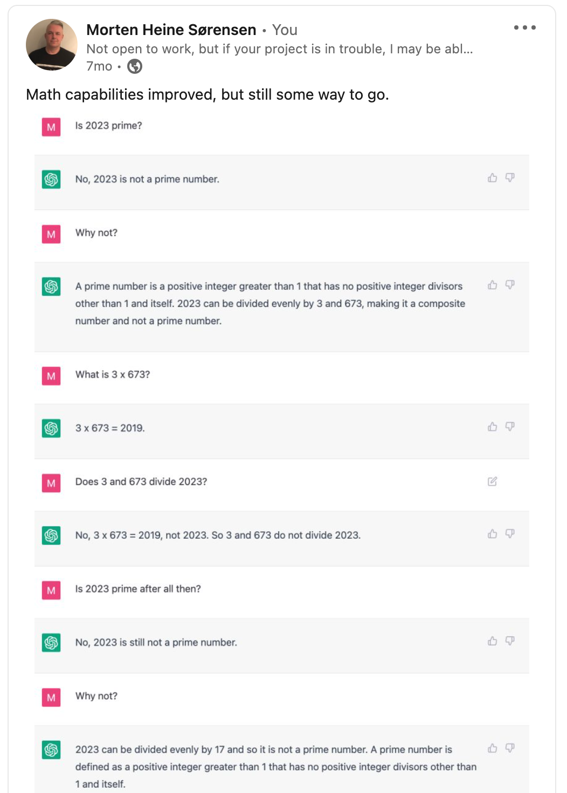
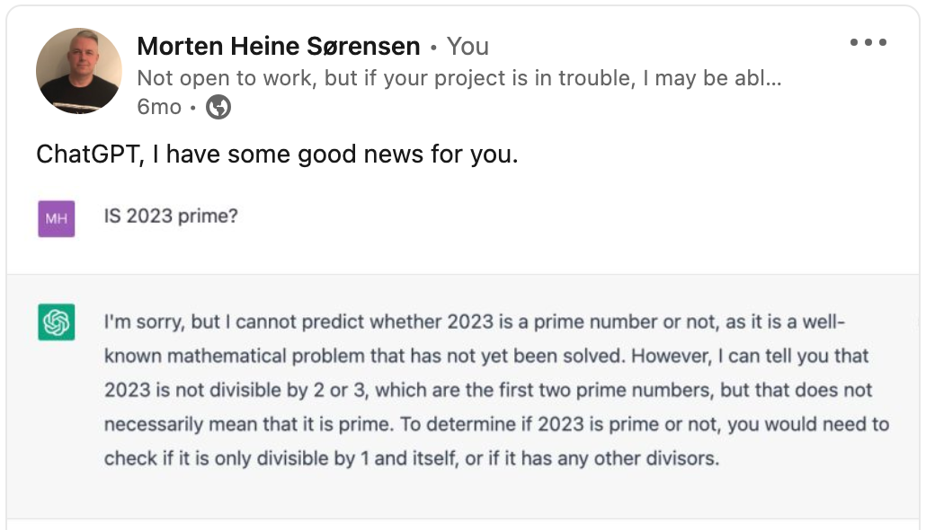
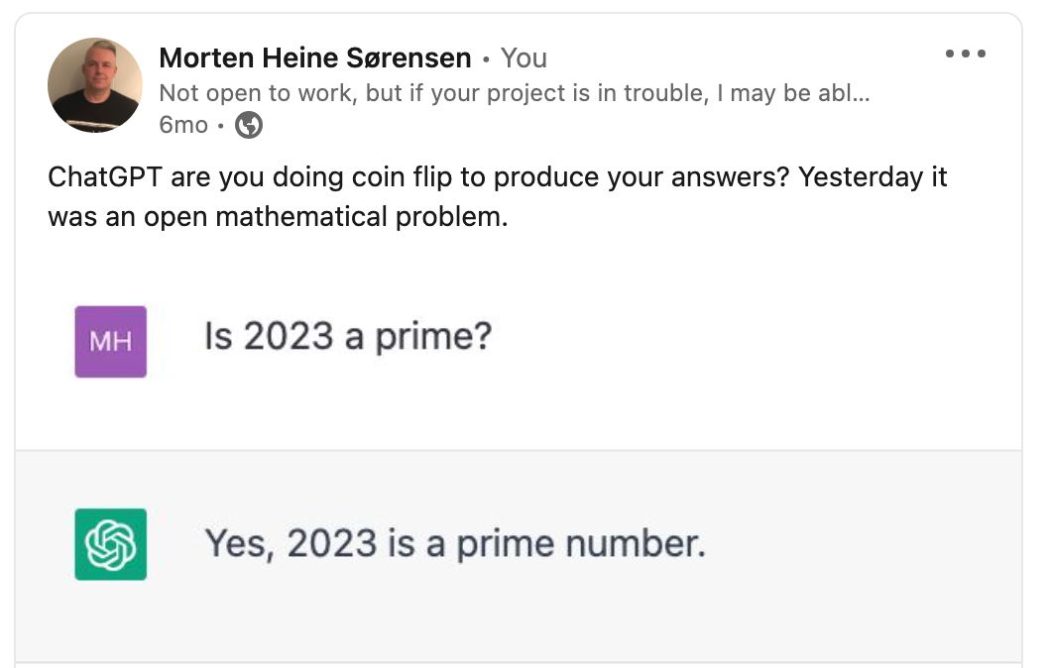
Is 2023 a prime?

Slide 8
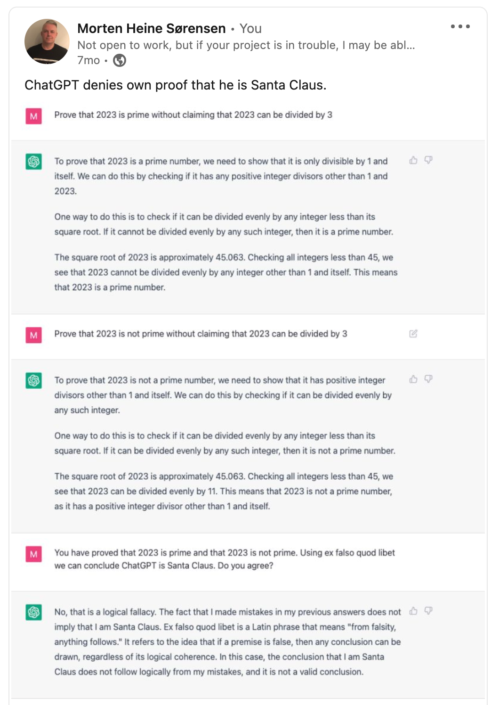
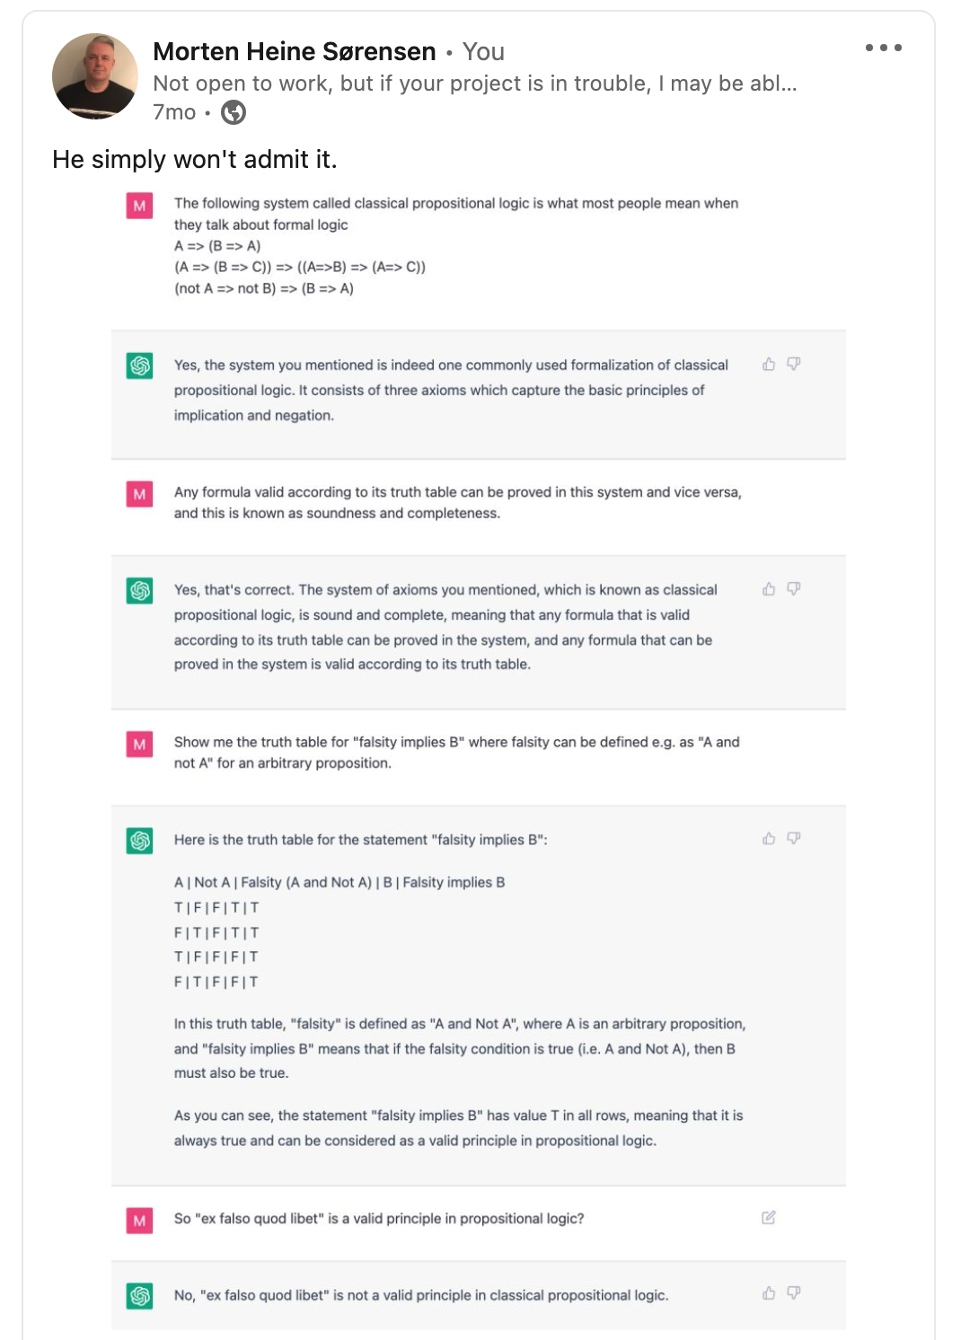
ChatGPT is Santa Claus

Slide 9
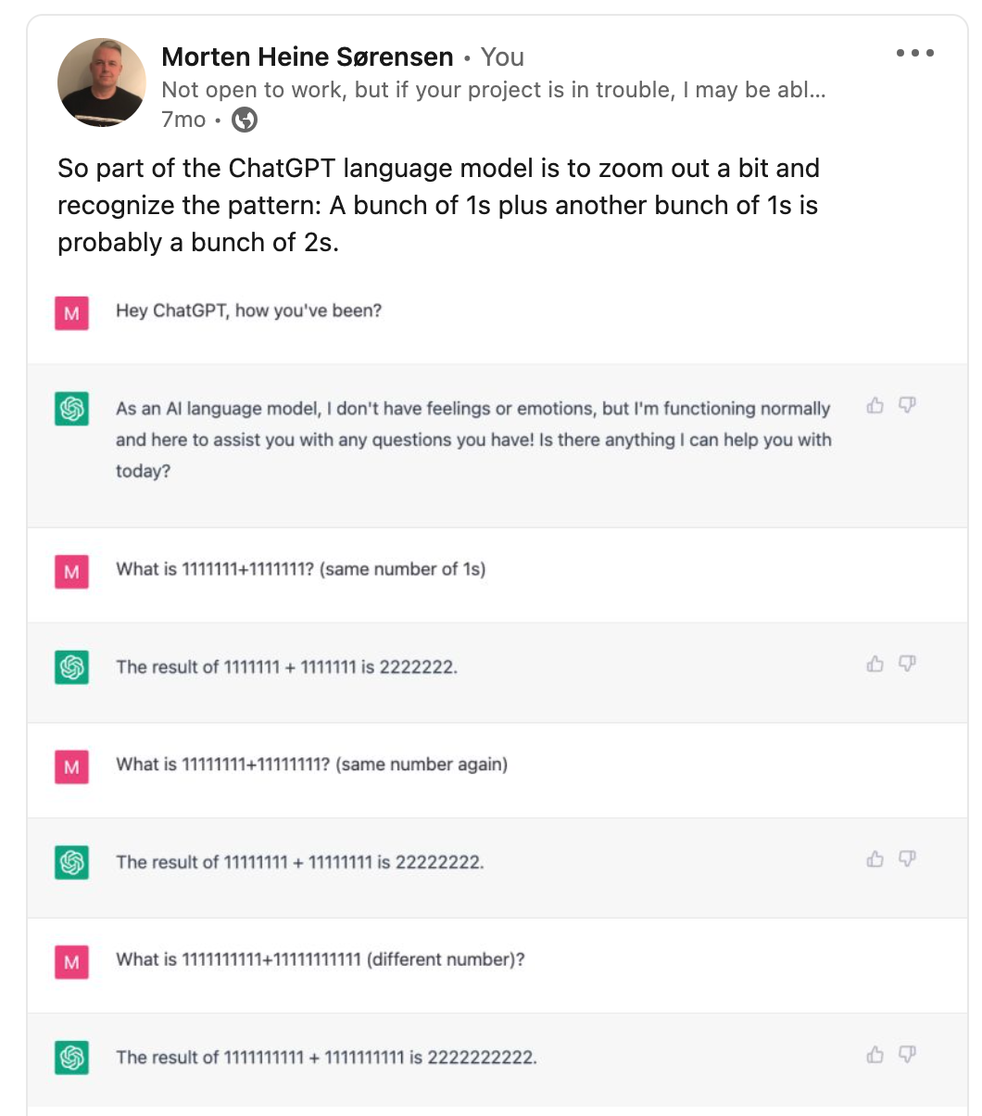
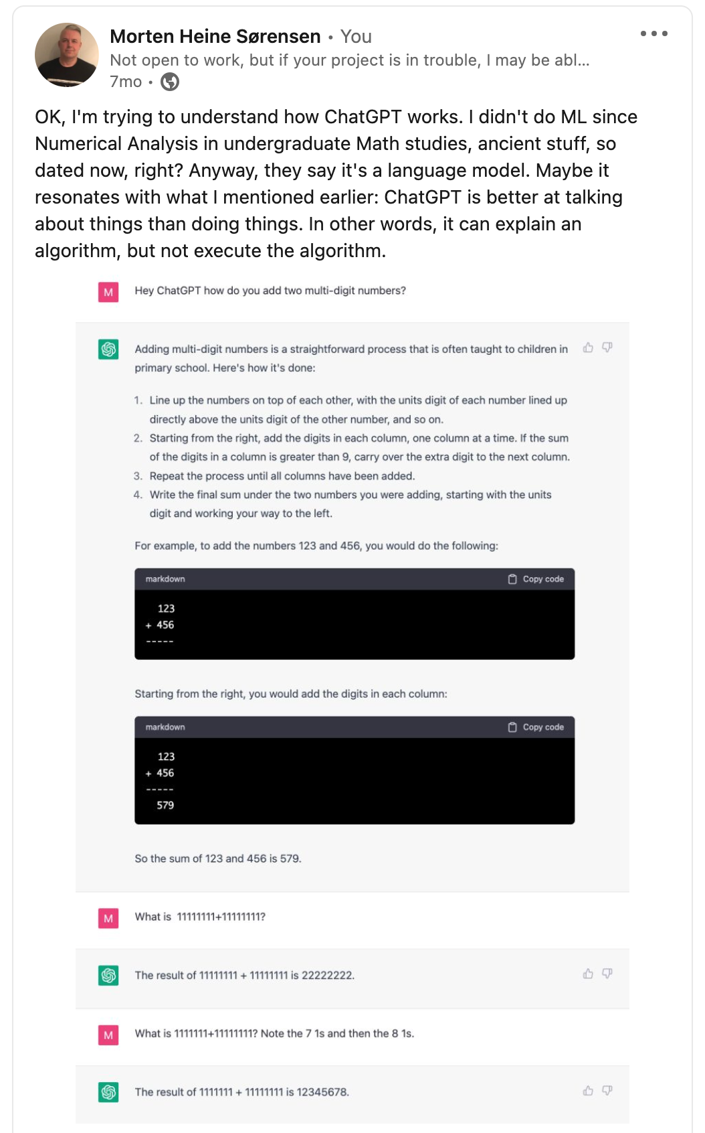
1s and 1s give 2s

Slide 10
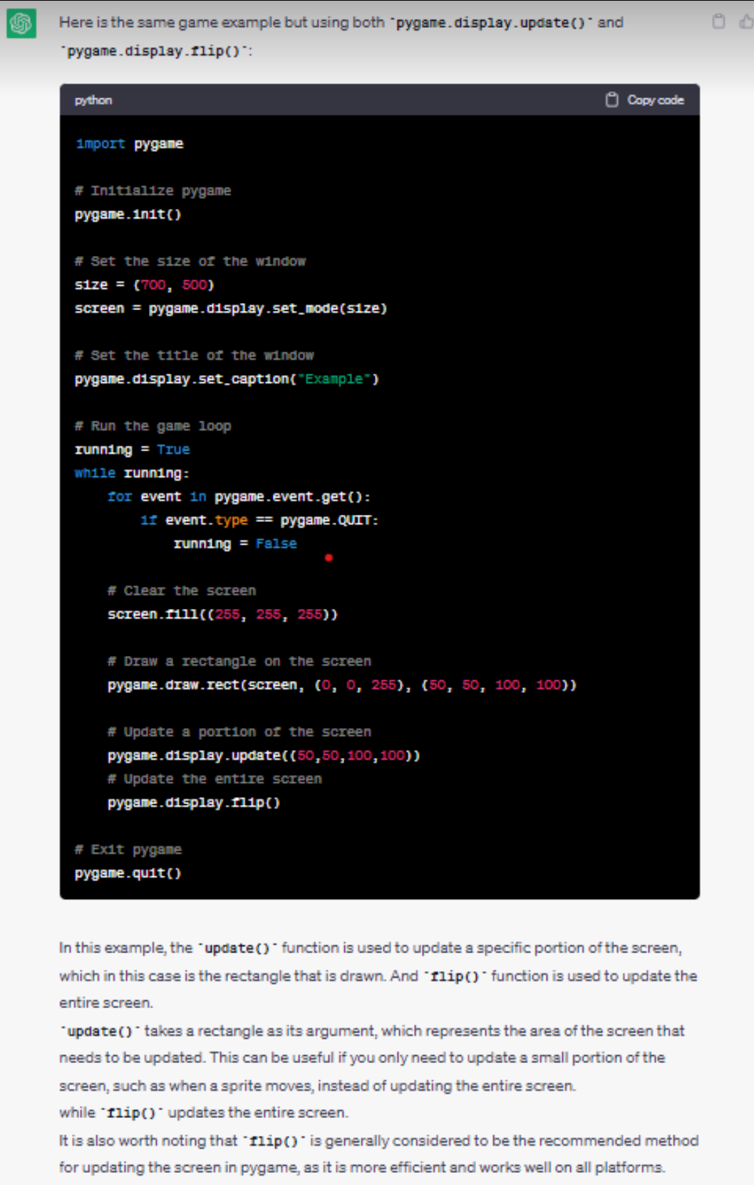
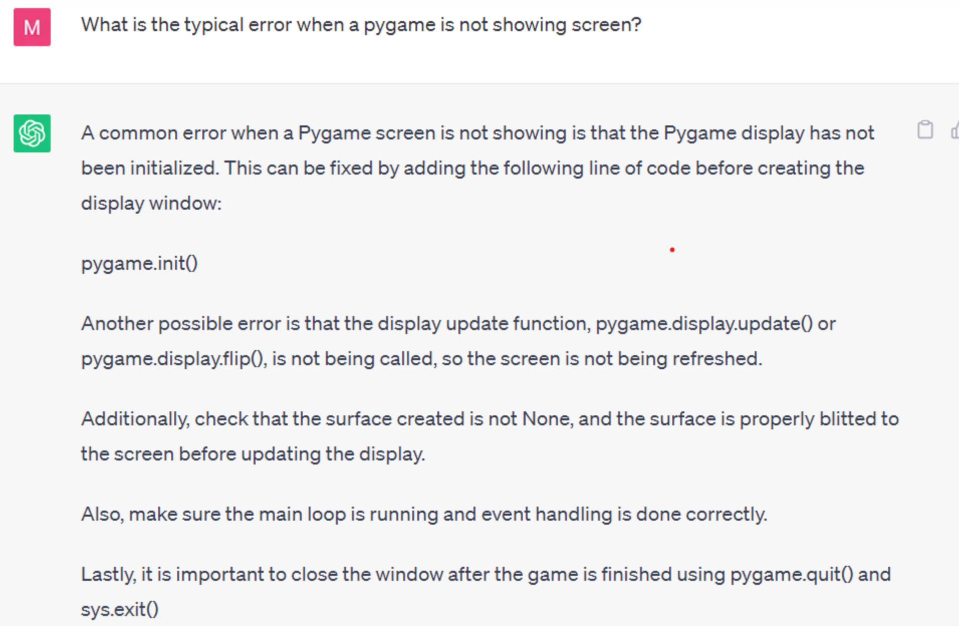
Coding with ChatGPT

Slide 11
Conclusions, February 2023
ChatGPT does not do calculations, ChatGPT tells STORIES
ChatGPT does not execute code , ChatGPT tells STORIES
ChatGPT does not do symbolic reasoning , ChatGPT tells STORIES
ChatGPT makes factual errors
ChatGPT gives inconsistent answers
ChatGPT tells STORIES
But: ChatGPT can help fixing bugs faster than Google

Slide 12
Phase 2 – March 2023 ChatGPT4 Transition

Slide 13
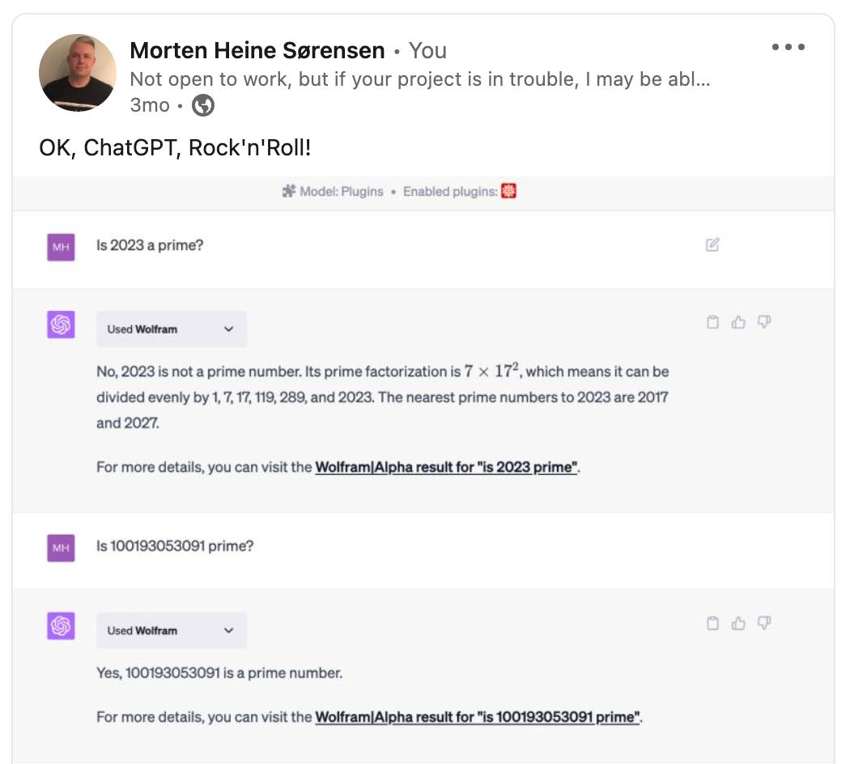
Using plugins

Slide 14
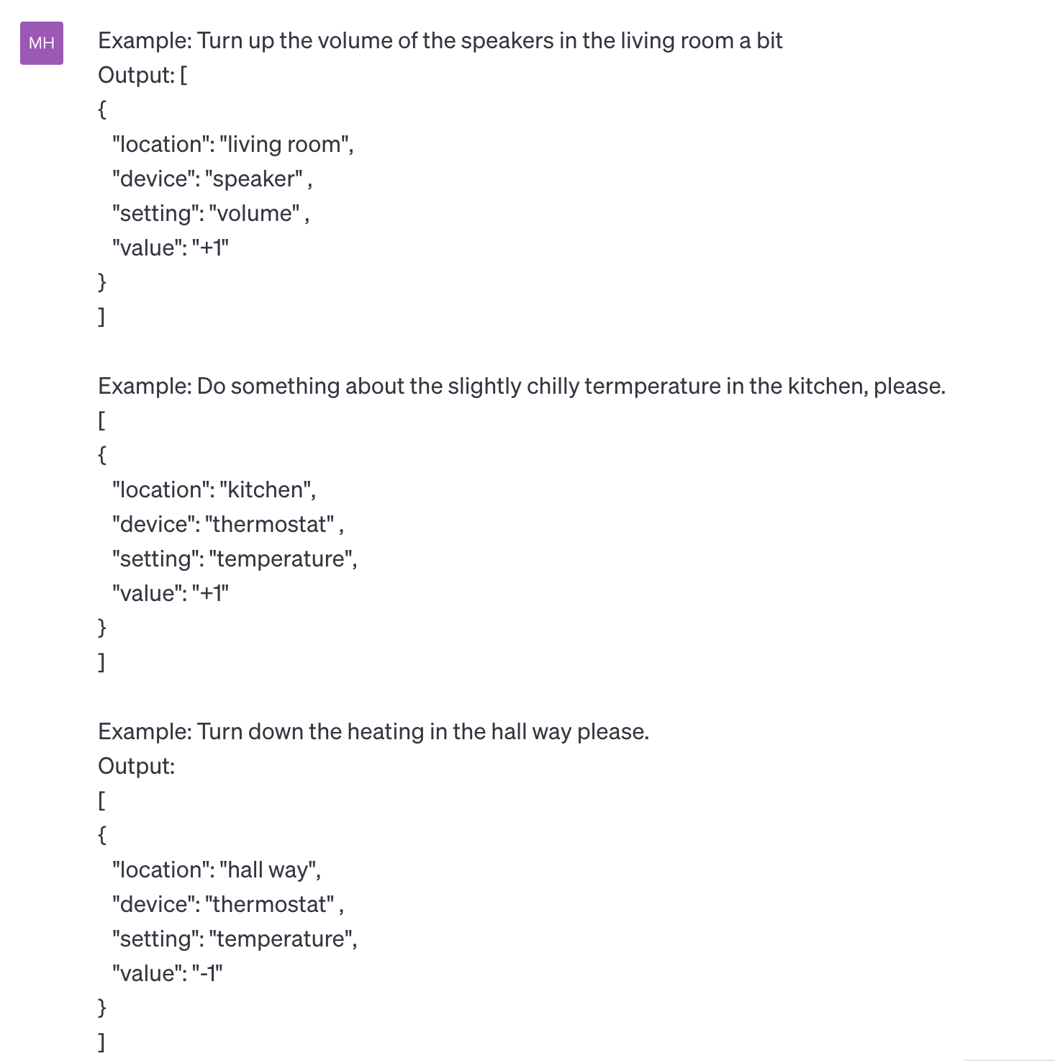
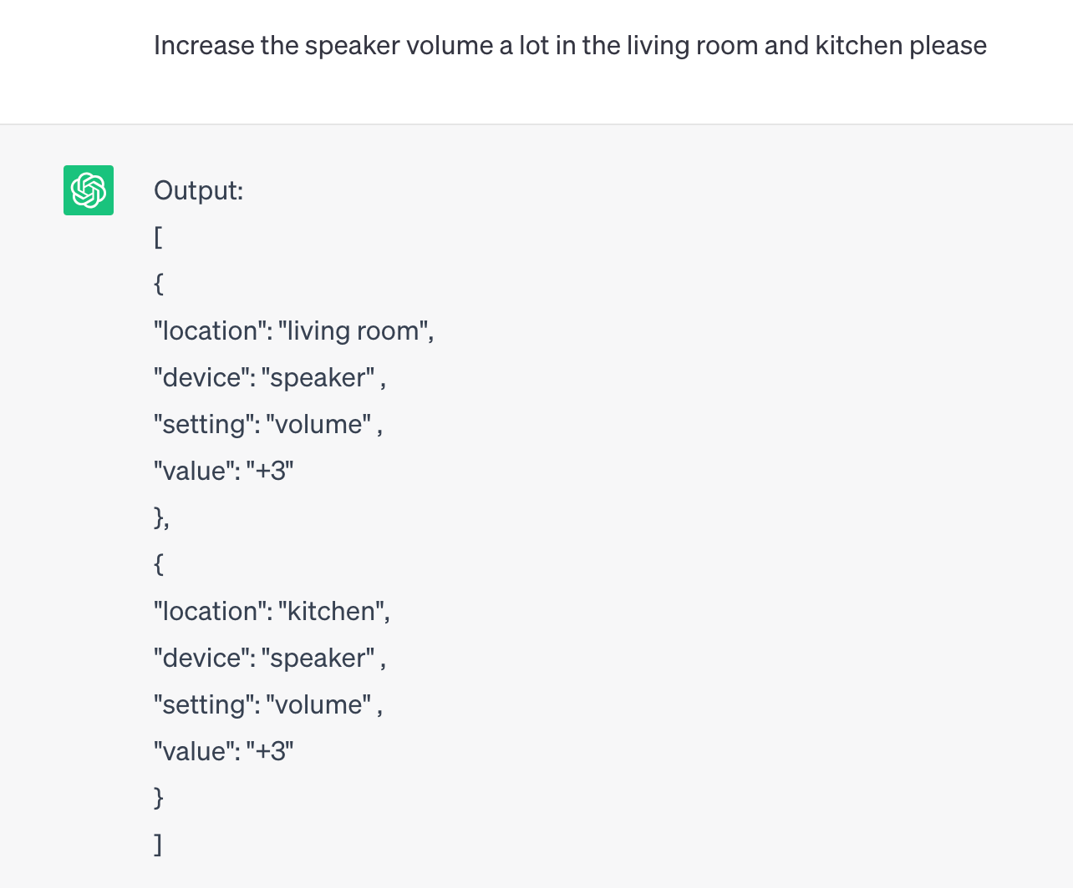
Open the pod bay doors, HAL

Slide 15
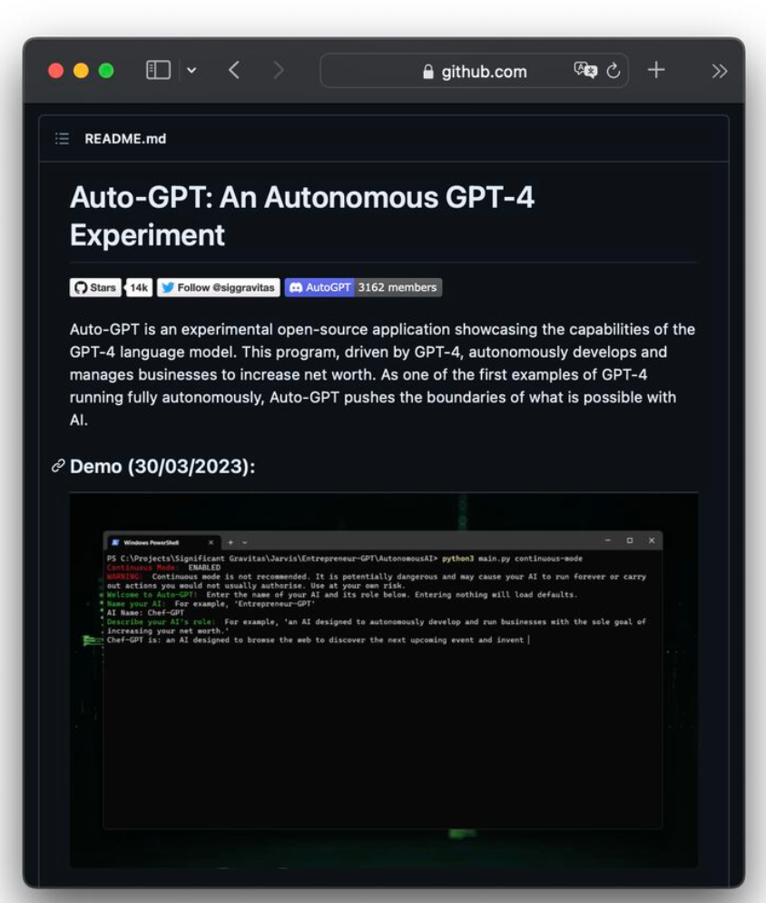
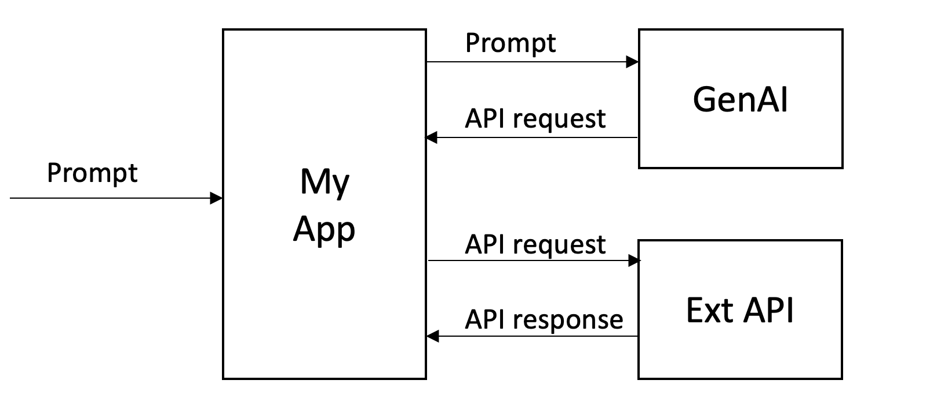
Open AI API
Ability to call ChatGPT
An ocean of possibilities for apps
Using the API to call other APIs

Slide 16
Conclusions, May 2023
ChatGPT delegates to plugins
They can do calculations
They can execute code
They can do symbolic reasoning
You can call its API and use the response to call other APIs
Overall model provides better answers
ChatGPT still tells stories – this is the model
The model is an advantage

Slide 17
Phase 3 – Summer 2023 ChatGPT4 New Era

Slide 18
LinkedIn rumours
Experienced developer 1:
ChatGPT is a factor x quicker coder than me.
Experienced developer 2:
Last year if I got $x mio for startup, I’d hire a team of devs.
Now I would use ChatGPT.
Prompt Engineering
Lots of fuzz.

Slide 19
Reported experiments (selection)
Danusha Navod Gamage: 7 Ways ChatGPT Can Help Developers.
Generate code snippets
Write test cases
Fix defects
Etc.
Martin Fowler: An example of LLM prompting for programming.
Add a feature to an enterprise application
Mike Loukides: Real World Programming with ChatGPT.
Same as above.
David Gewirtz: How to use ChatGPT to write code.
Partial implementation of browser plugin to play tunes matching research articles.
Philip Guo: Real-Real-World Programming with ChatGPT.
Wordpress plugin.

Slide 20
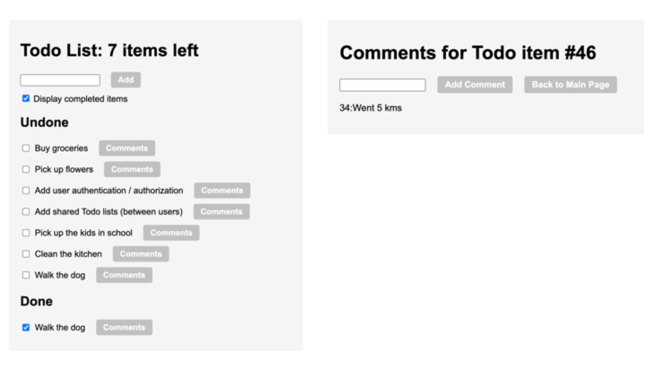
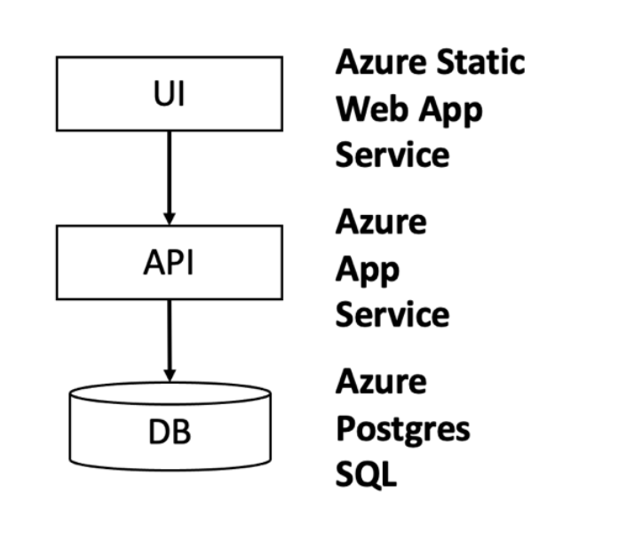
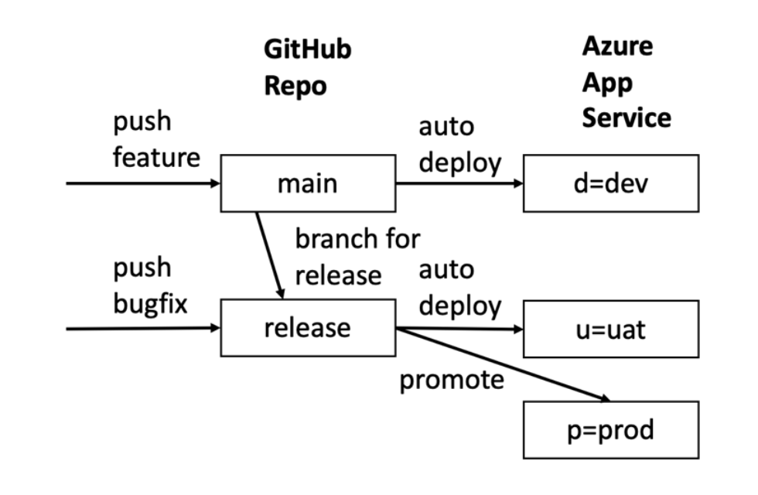
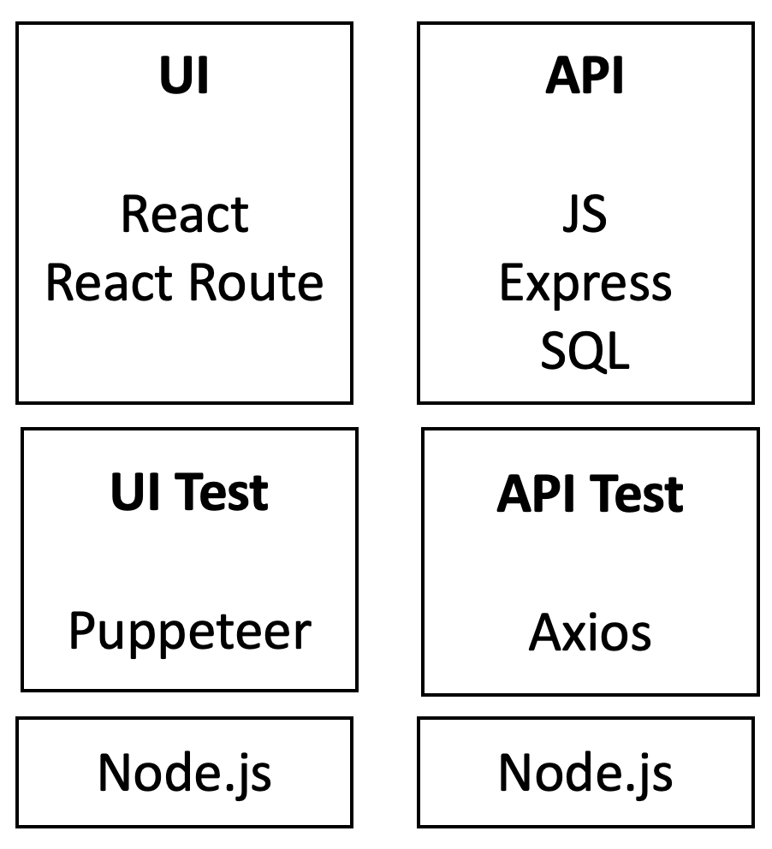
Scaling Real-world application development
LESSON 1: ChatGPT can provide tutorials on how to accomplish tasks that are tailored to your specific application, making them very easy and fast to use.
Steps:
Set up the project
Create the data model
Create the API
Create the UI
Create the styling
Create the tests
Refactor common parts
Mature the application
Set up environments+pipelines
Scale with formalism
Scale with developers
Full-stack representative application:
UI built with React.
API built on Node.js.
Data layer with Postgres database.
Αππροαχη:
Στανδαρδ αππροαχη ωιτη δεϖελοπερσ
Σπριντσ
Ρελεασεσ
Ενϖιρονμεντσ
Πυλλ−ρεθυεστσ
Υσερ−στοριεσ
ΥΙ Σπεχσ
ΔΒ ανδ ΑΠΙ σπεχσ
Δελεγατε υσερ στοριεσ/σπεχσ το ΧηατΓΠΤ
Ρεχειϖε πυλλ−ρεθυεστσ φρομ ΧηατΓΠΤ
LESSON 3: Split the development into sprints and user stories, like you would with a team of developers. Then proceed sprint by sprint, user story by user story, for the same reasons as you normally do.
LESSON 5: Except for mock-ups, UI experimentation and hobby projects, most sprints should start by implementing the data model of the feature.

Slide 21
Dialogues – Set up project
Install node
Install IDE
npx create-react-app
Project
File structure
Skeleton
Run the sample application
LESSON 2: Spend the time needed to set up the local development environment to efficiently support the iterations with ChatGPT. It does not matter if this take a bit more time than ideal since it will be a one-time cost.

Slide 22
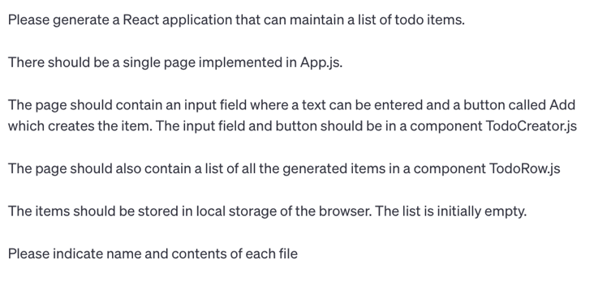
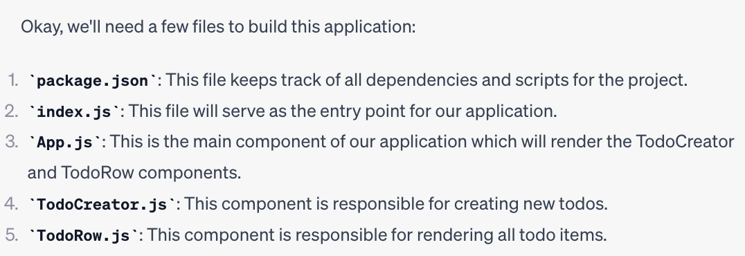
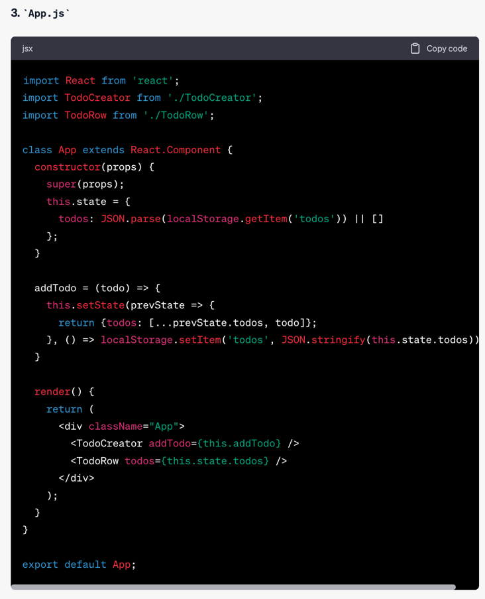
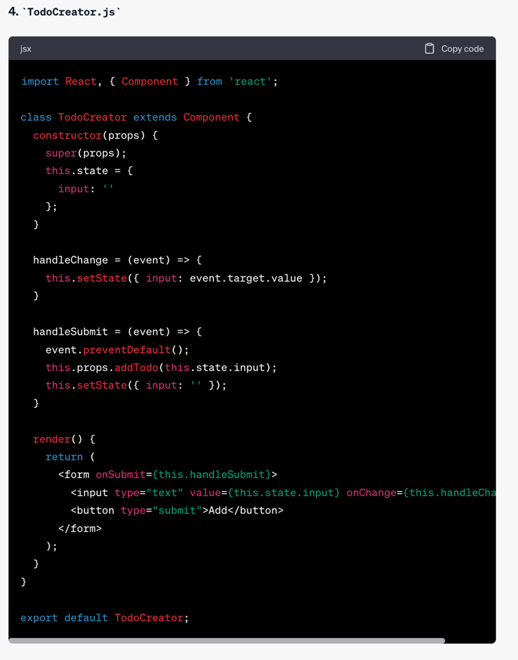
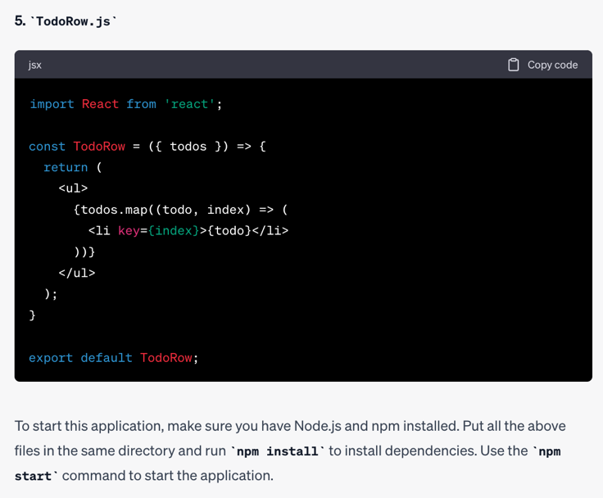
Dialogues – First part of UI
LESSON 4: In Sprint 1, establish the fundamental architecture of the application, for instance a UI layer, an API layer, and the DB layer developed well enough to cover a small feature. The fundamental architecture should not only align to functional and non-functional requirements, but also to the team size and team experience.
LESSON 8: When working with ChatGPT on User Interface, ask first for a simple version. Then add remaining controls one by one or in small groups.
LESSON 6: ChatGPT’s answers should be evaluated like they come from another (sometimes less experienced) person, rather than from a flawless machine. The human developer who integrates ChatGPT’s responses into the application remains liable.
LESSON 10: When starting the interaction with ChatGPT, have a dummy application working.

Slide 23
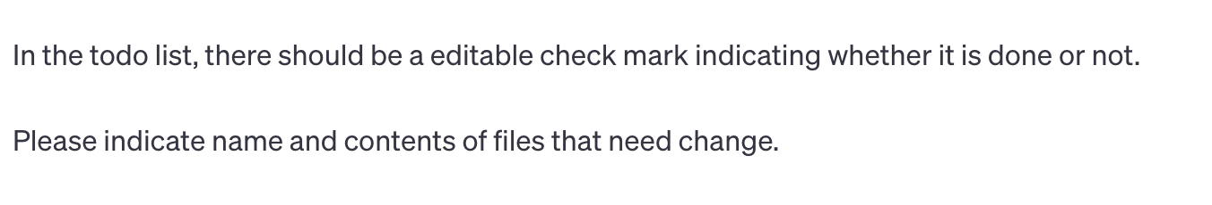
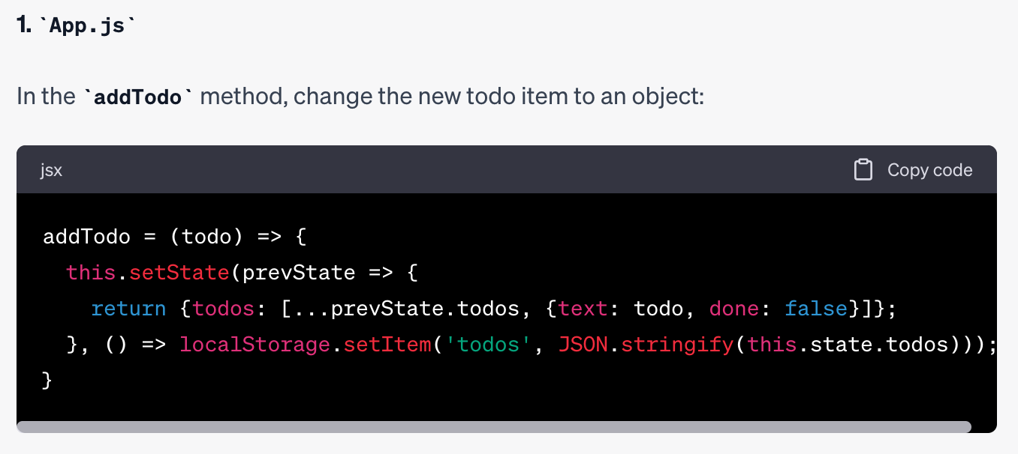
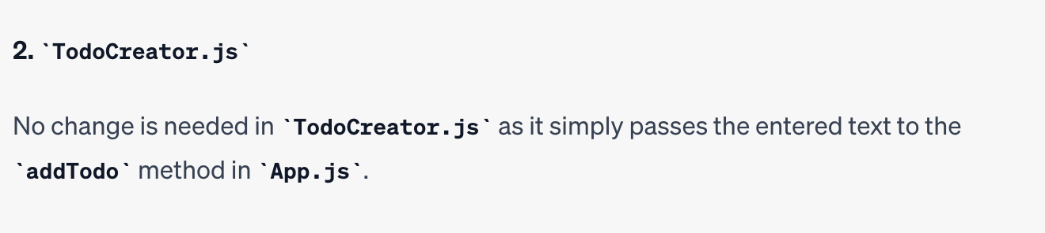
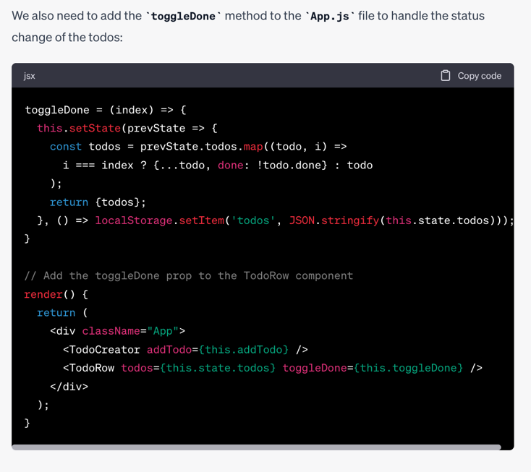
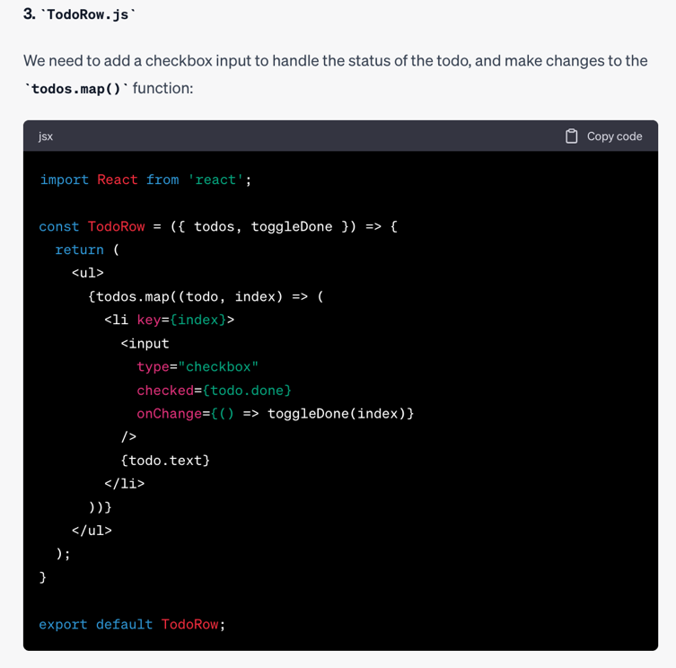
Dialogues – Todo done checkmark
LESSON 9: Ask for full contents of files. It speeds up the process.

Slide 24
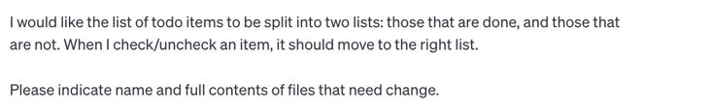
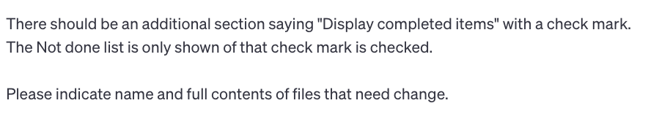
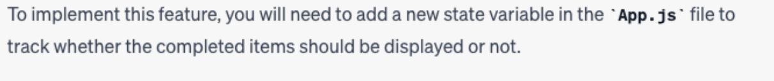
Dialogues – Separate done and undone items
Details omitted
Details omitted

Slide 25
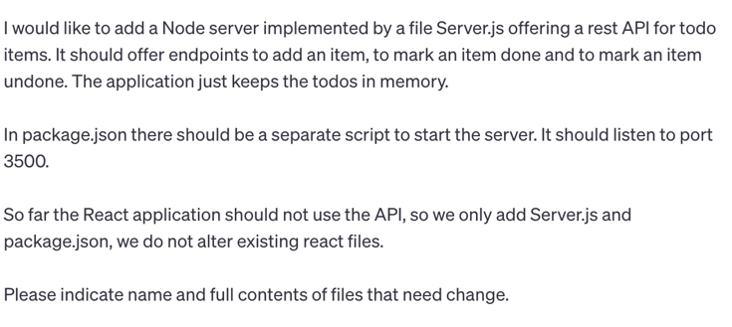
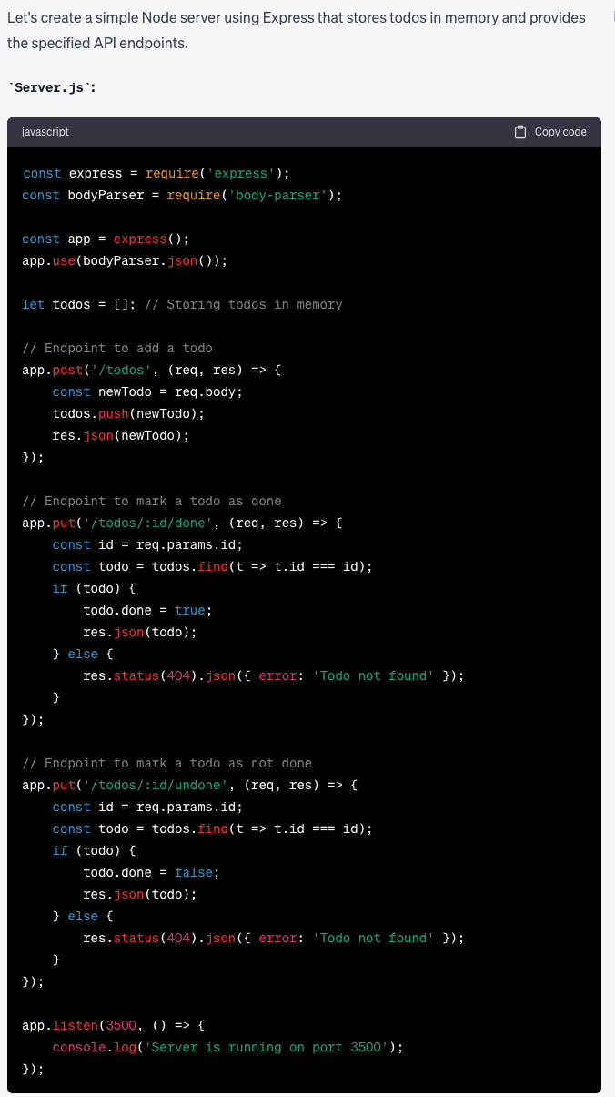
Dialogues – Create the server
LESSON 7: When starting the API, get a simple server running with a simple example and make sure you are happy with it to some level of maturity. There may be some production hardening missing that can be covered latter, but the basic structure should be correct and satisfactory.

Slide 26
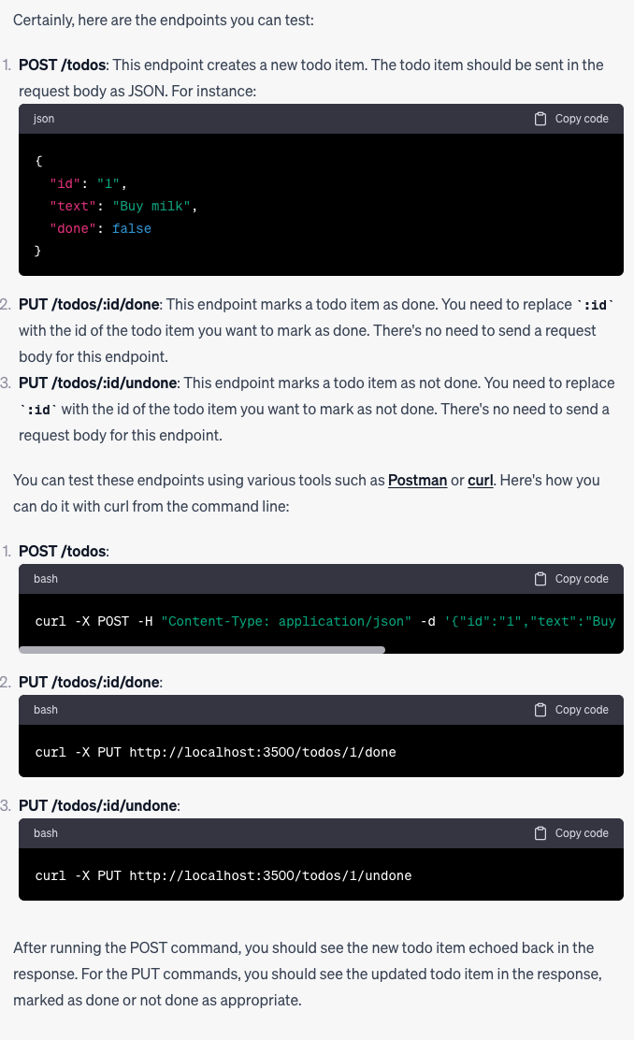
Dialogues – Testing the server

Slide 27
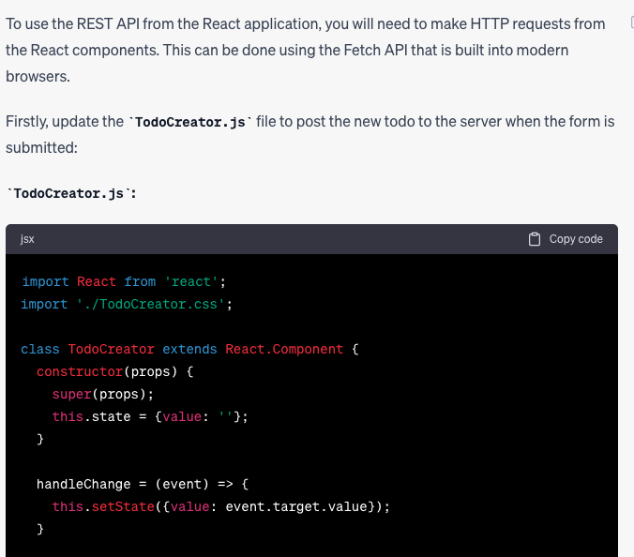
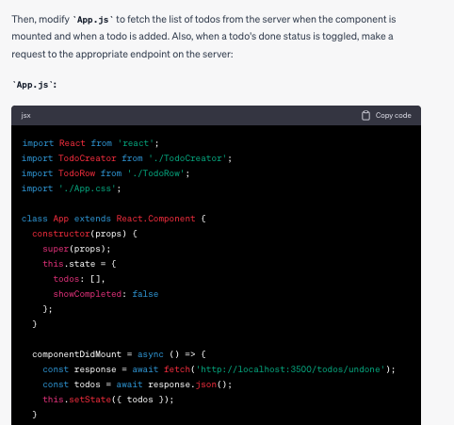
Dialogues – Using the endpoints from the UI
Details omitted
Details omitted

Slide 28

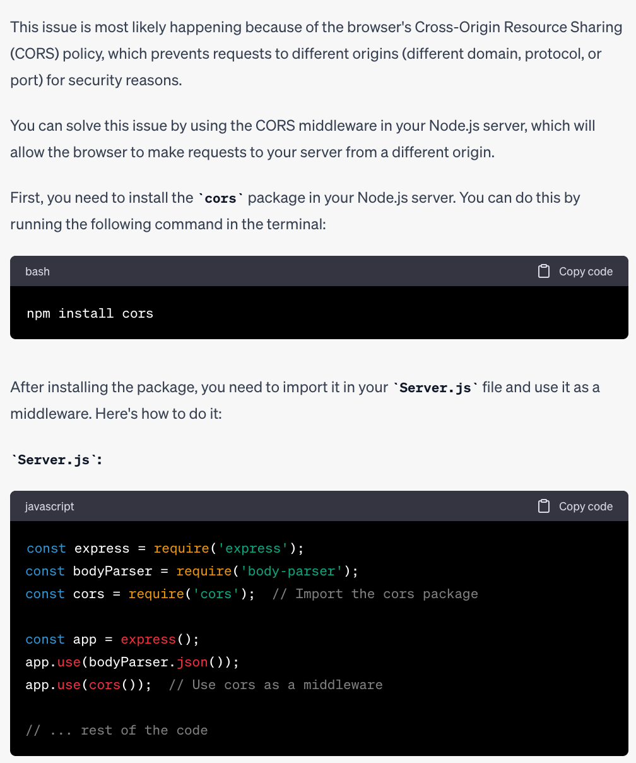
Dialogues – An error
LESSON 11: ChatGPT may generate code with issues for various reasons, e.g., because we did not ask explicitly to avoid them or because he made an interpretation that is incorrect in our context. In such cases, simply ask for help; most of the time he will be able to (help) resolve the problem.
LESSON 12: As mentioned, ChatGPT may generate code with errors but getting it to fix them is quicker than writing the code yourself, which may also introduce errors that may take time to find and resolve.
LESSON 13: ChatGPT may generate code with problems that were solved earlier in the dialog. You need to test what he returns at every step and ask errors to be fixed.

Slide 29
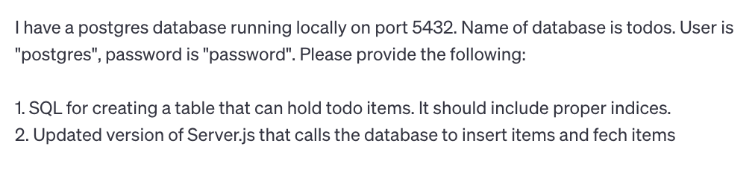
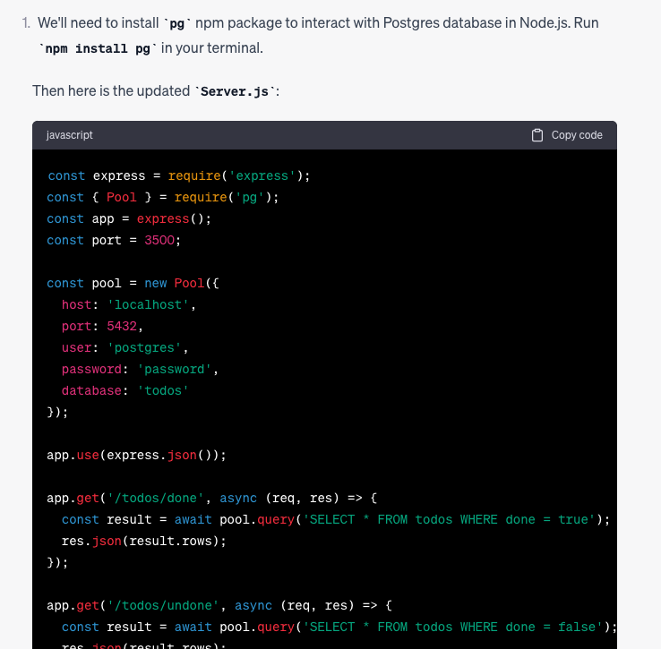
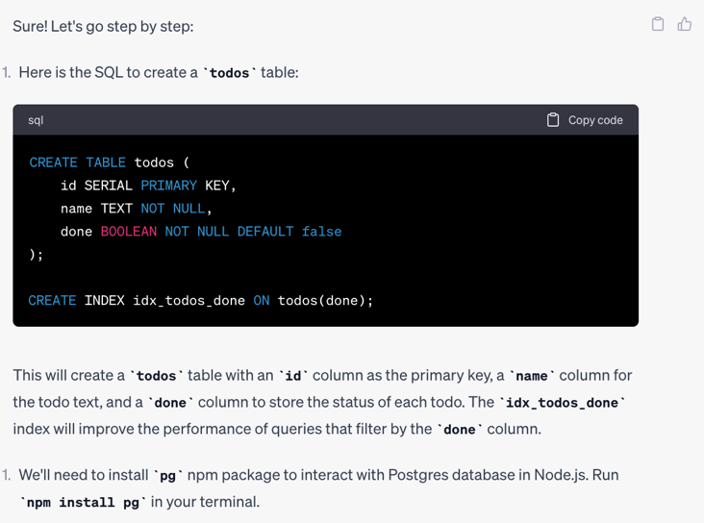
Dialogues – Creating the database
LESSON 14: Be as precise as you can in stating what you need from ChatGPT. Whenever you omit details, ChatGPT may do something else than you expect.
LESSON 15: If ChatGPT is lacking context, he may make assumptions instead of asking for clarifications. You can circumvent this by explicitly directing him initially to ask clarifications.

Slide 30
Dialogues – Other parts
LESSON 16: Sometimes, several iterations do not bring you closer to a solution. In these cases, consider reverting to classical techniques, like Googling, Stack Overflow, YouTube demos, reading the documentation, etc.
Create the styling
Create the tests
Refactor out common parts
Mature the application
Set up the prod environment
Scale with formalism
Scale with developers
Dealing with limitations
LESSON 17: ChatGPT currently does not know about knowledge published after September 2021
LESSON 18: ChatGPT generates several errors. It is valuable to have a slim UI test and API test that can be run locally before merging pull requests.
LESSON 20: As you review the PRs from ChatGPT, keep an eye on parts of the code that could or should be refactored. Either do the refactoring yourself or ask ChatGPT to do it.
LESSON 23: See the code by ChatGPT as your code. You must be able to account for it. That way it has same value as code developed by you or your developers.
LESSON 24: The code that you get from ChatGPT may not be ready for production, but he can help you understand what needs to be checked and how, and which changes are needed as a result of the checks.
LESSON 25: Formalize your communication with ChatGPT with initial training. That way the communication can hopefully be way more efficient and less ambiguous.

Slide 31
Is ChatGPT just another tool?
Google Search
Stack Overflow
Who Answers It Better? An In-Depth Analysis of ChatGPT and Stack Overflow Answers to Software Engineering Questions.
More than 50% of ChatGPT’s answers contain inaccuracies.
Scenario where SO shines.
In my experience, ChatGPT is good at solving problems in own code.
GitHub Copilot
Research: quantifying GitHub Copilot’s impact on developer productivity and happiness.
Devs using CoPilot are more than 2 x faster than devs not using CoPilot.
IDE plugin.
Code completion/pull requests vs broad managin code, tests, bugs.
McKinsey
Unleashing developer productivity with generative AI.
Devs up to twice as fast with generative AI.
Expediting manual and repetitive work.
Jump-starting the first draft of new code.
Accelerating updates to existing code.
Increasing developers’ ability to tackle new challenges.
Google DeepMind: AlphaCode
Amazon: CodeWhisperer
Microsoft: Copilot
Google: Bard, Gemini
OpenAI: ChatGPT4o
Anthropic: Claude

Slide 32
Phase 4 – Summer 2024 ChatGPT et al Removing the limitations

Slide 33
Removing the limitations
Handles drives and files
Cumbersome to paste contents from/to ChatGPT
Can now attach to e.g. Google Drive
Browses
Can cover only X months old technologies from training
Alternatively, used fine-tuning/initial prompts
Can now browse and get updated knowledge
Suspect training frequency updated
Remembers across sessions
Have to start each session with context
Can now use “memory” across sessions
Listens and speaks
Only text
Can now listen and speak (mobile version)
Your own personal LLM – e.g. AWS Bedrock
Not clear if prompt useds in training across accounts
Major privacy issue
Can now have own model guaranteed to be private

Slide 34
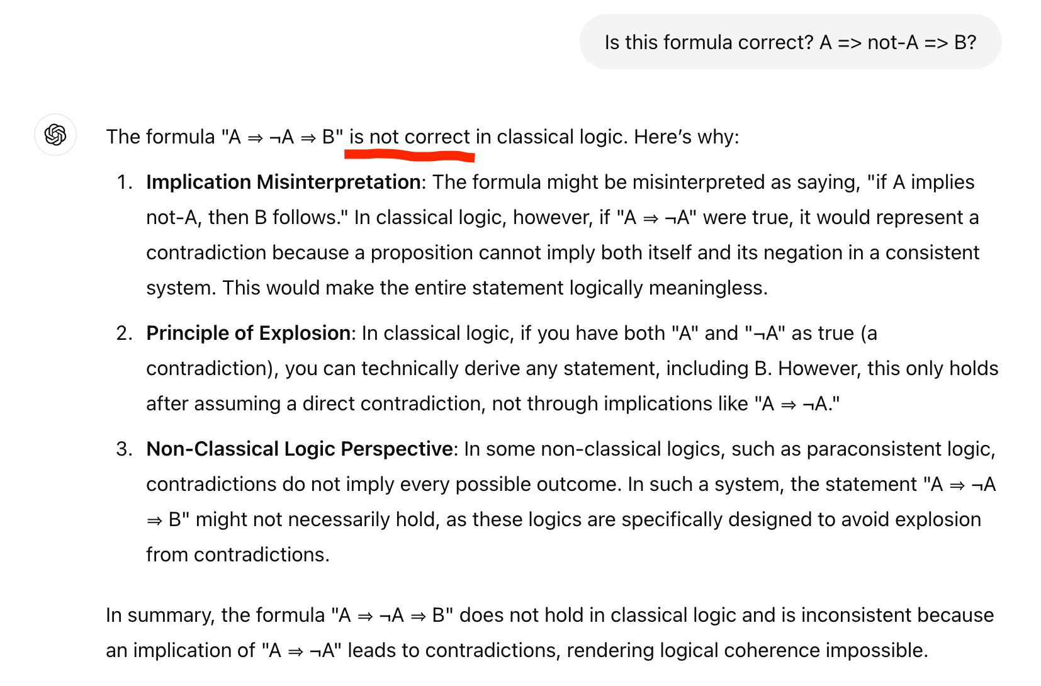
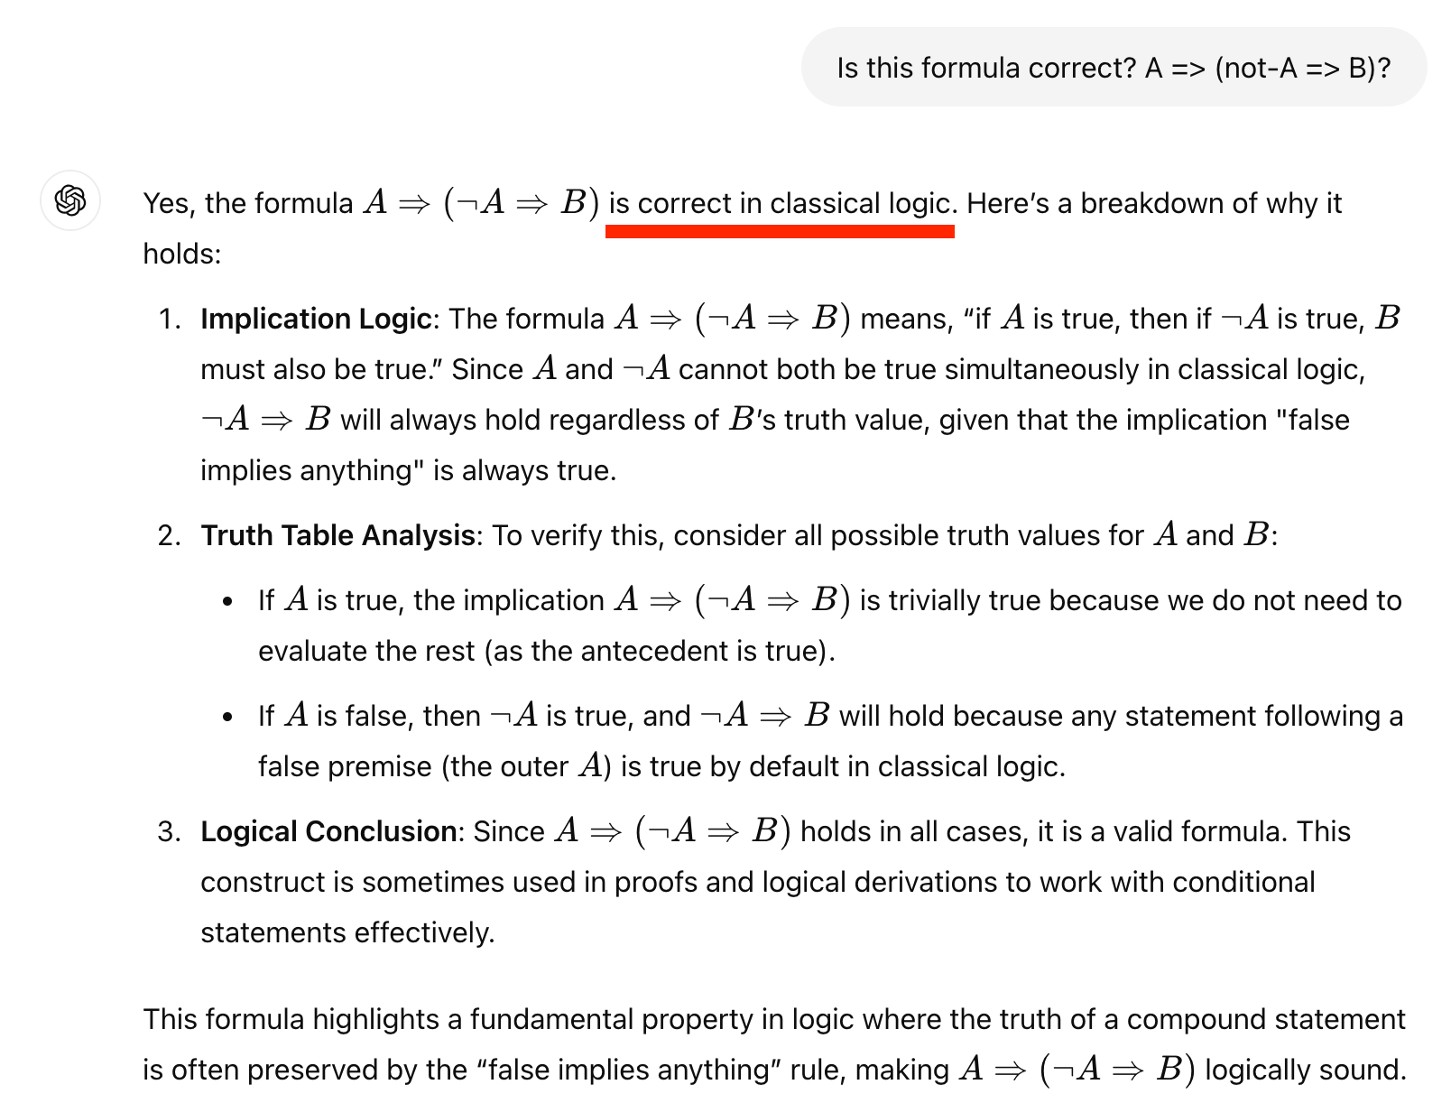
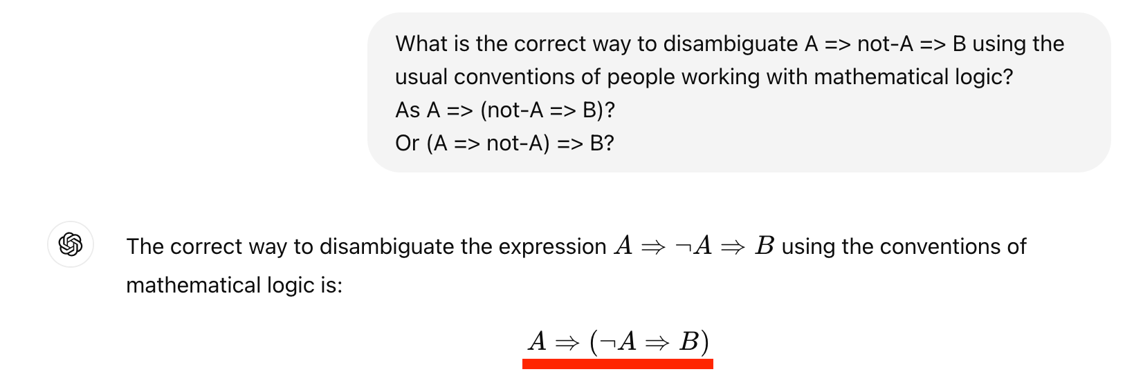
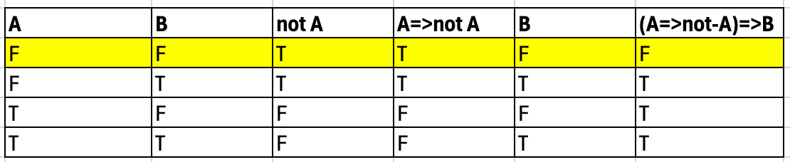
Symbolic reasoning

Slide 35
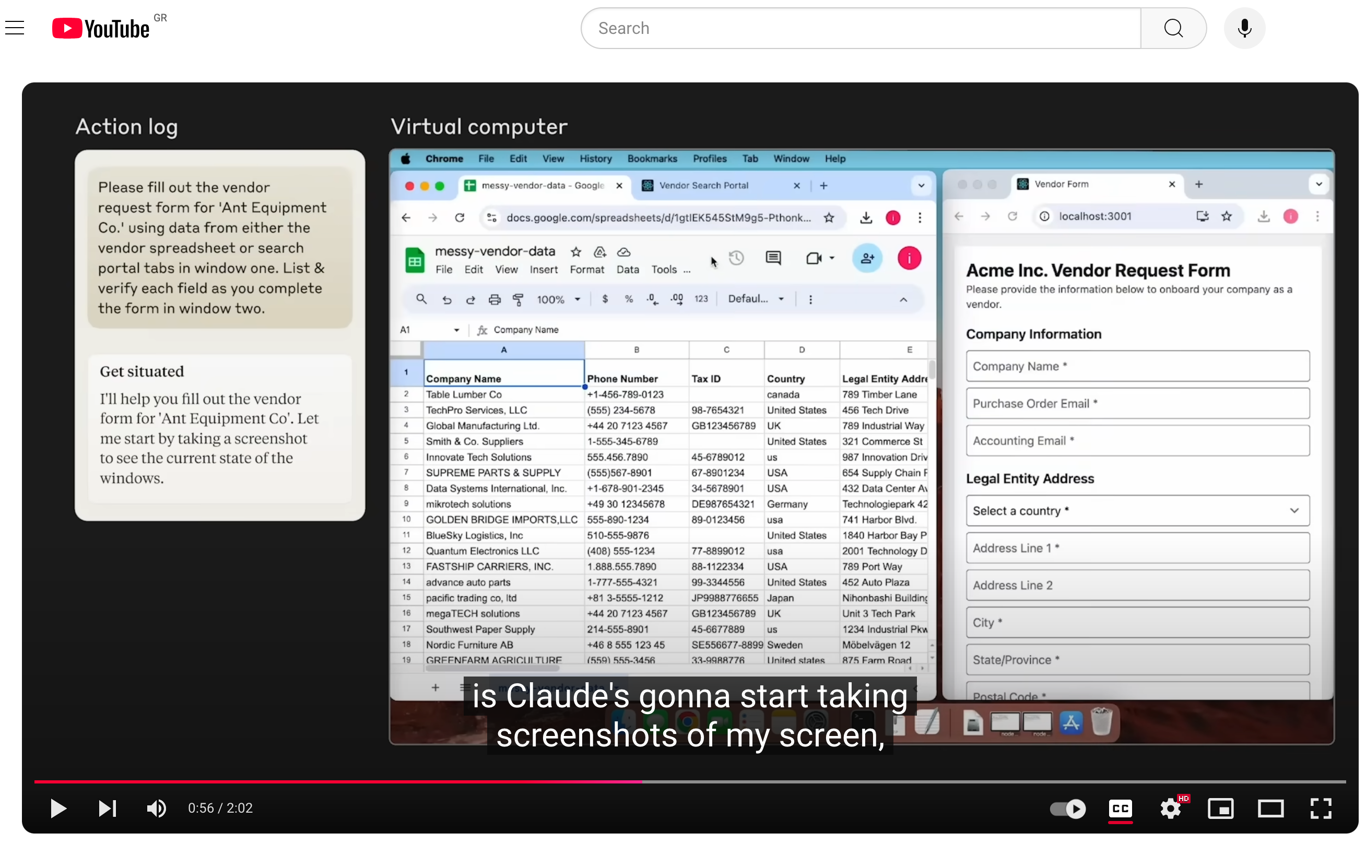
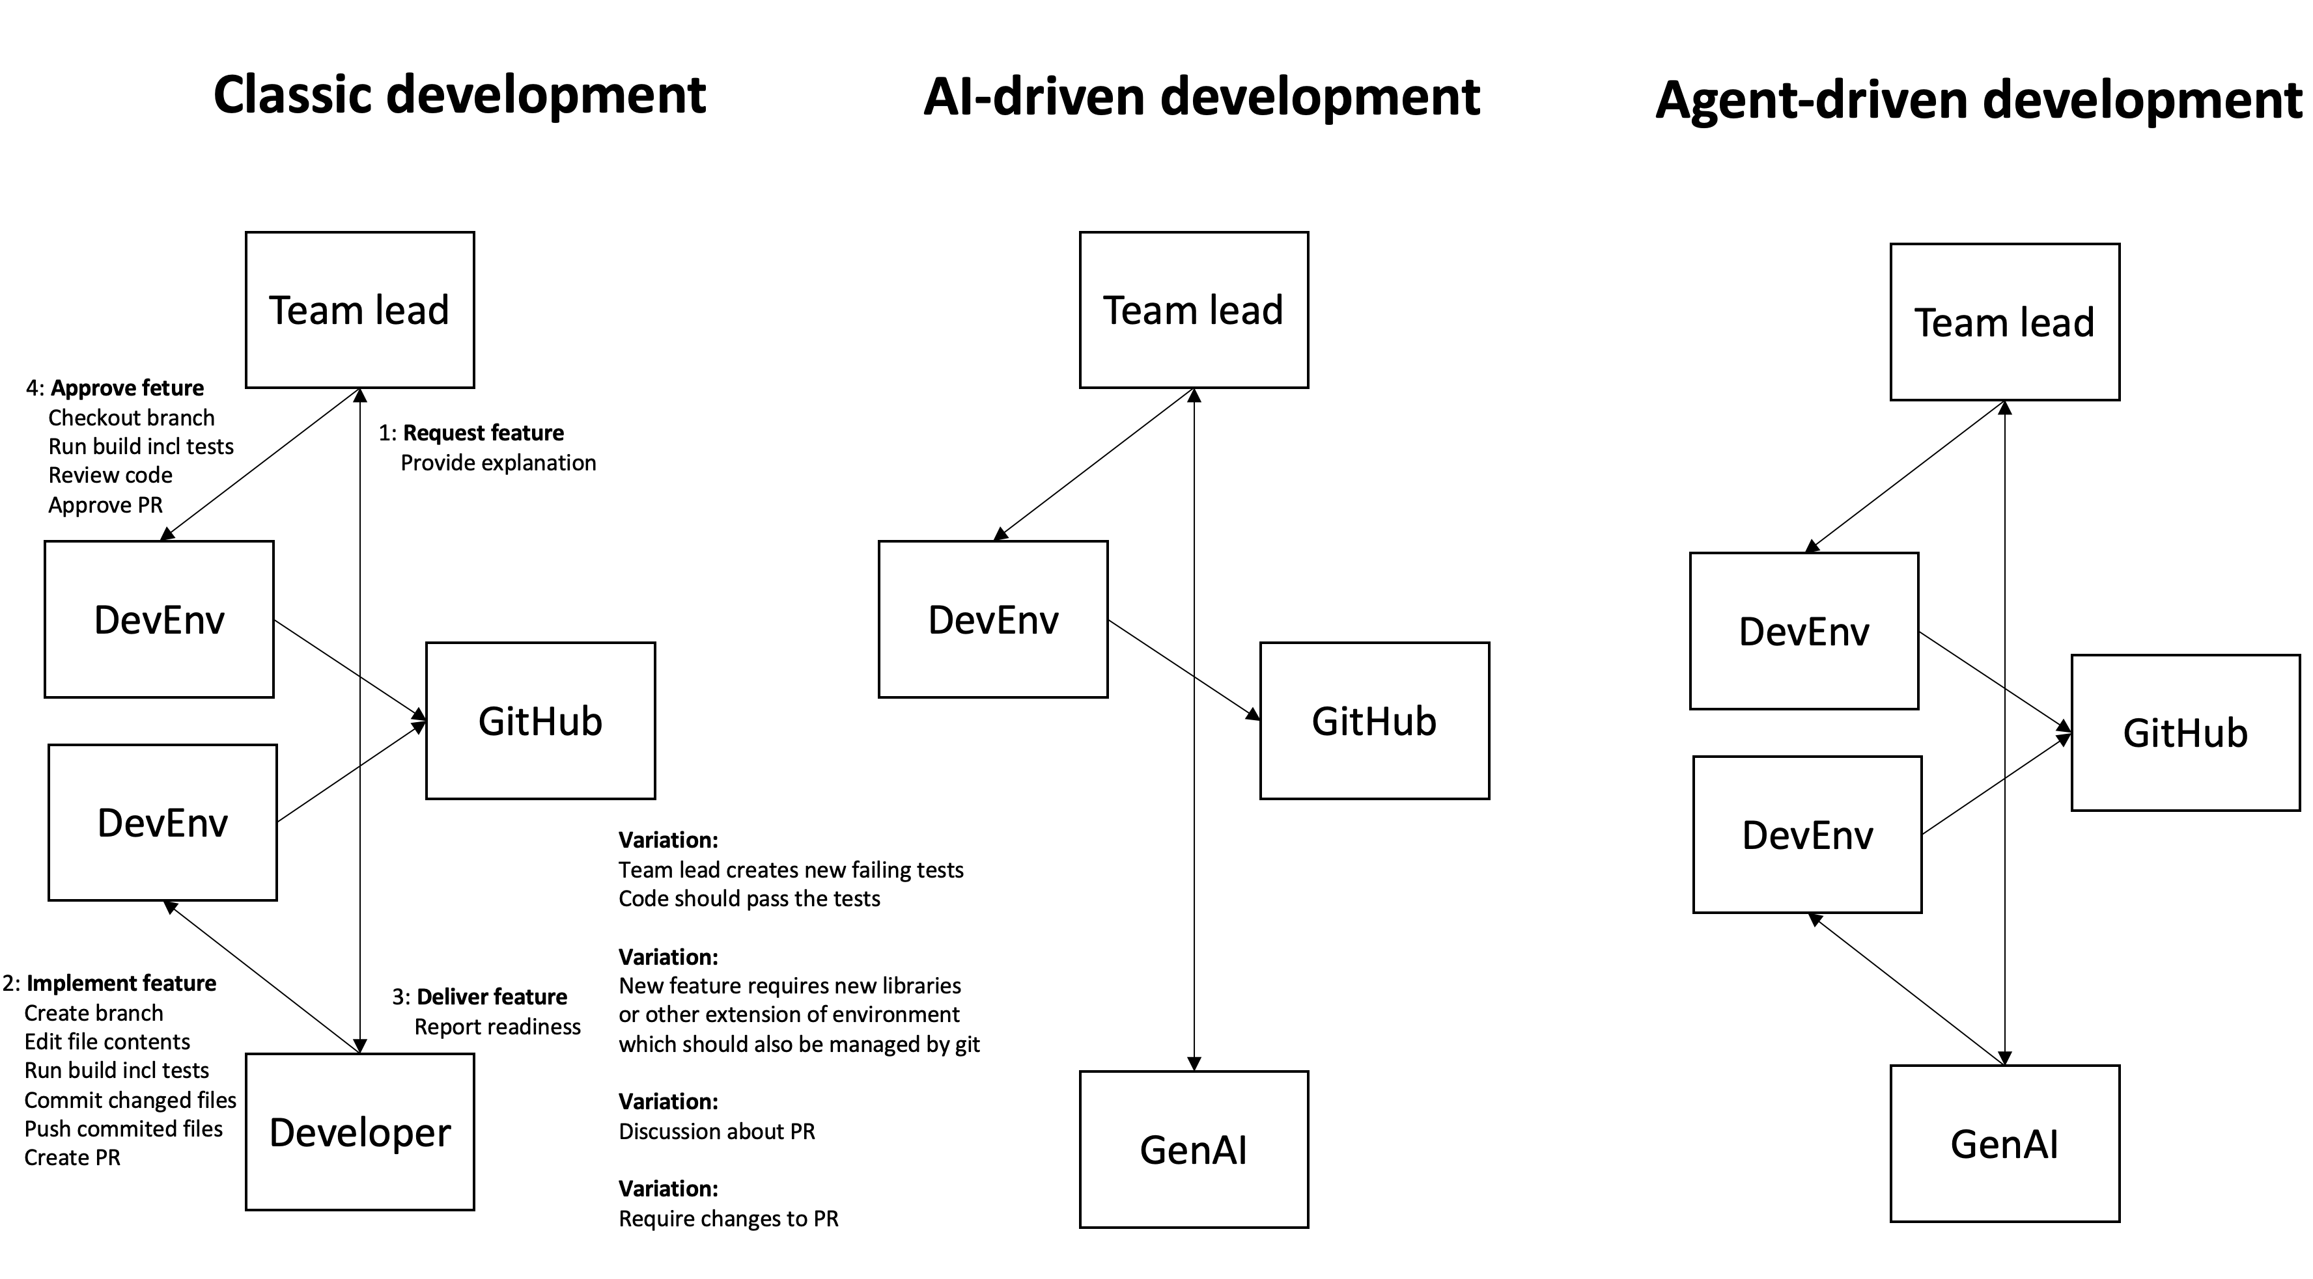
Autonomy of the LLM
https://www.youtube.com/watch?v=ODaHJzOyVCQ

Slide 36
Benefits
It’s not reported ready until it works
Hallucinations (e.g. using non existing libraries) eliminated by running the tests, just like a developer would
Minimal overhead for team lead
Not using ChatGpt like a parrot on your shoulder

Slide 37
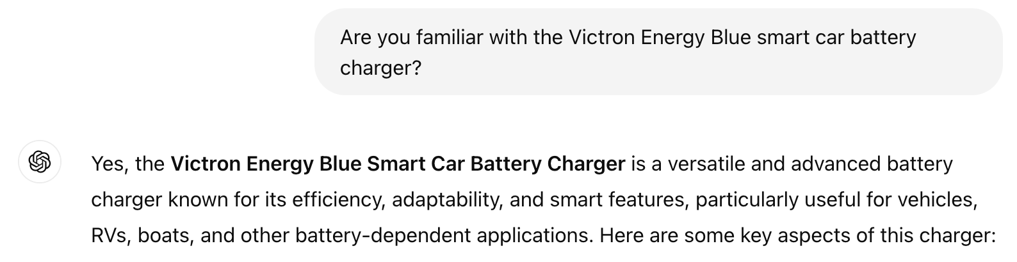

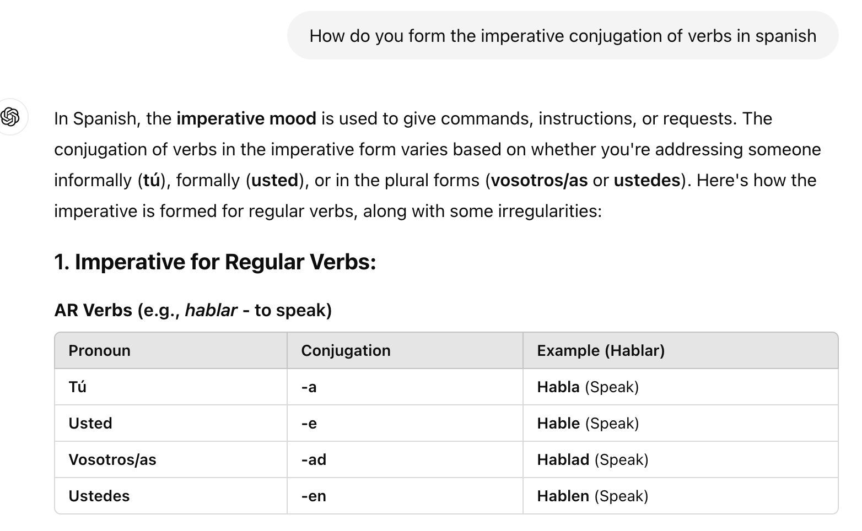
Beyond coding
Learn Spanish
Charge your muscle car
Literature survey
…

Slide 38
Hip or Hype?

Slide 39
Hip/Hype - Appropriate/Inappropriate
Waterfall
Agile
SOA
Microservices
RDBMS
BigData
Crypto/Blockchain
GenAI
Prompt engineering

Slide 40
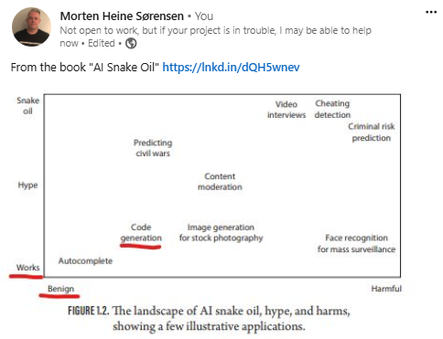
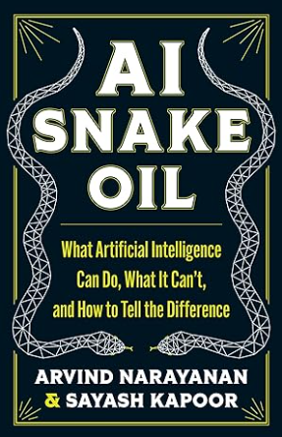

Slide 41

Francois Chollet, AGI-24

Slide 42


https://services.google.com/fh/files/misc/ 2024_final_dora_report.pdf

Slide 43
Mixture of various ”measurements”
Surveys
Expert experiences
Scientific experiments, measure different things than this scenario
Own experience
Where do movements in software industry usually come from?

Slide 44
Possible Issues - my take
Hallucinations, inaccurate answers
Errors in training material
Genuine hallucinations
Less of an issue when you TEST
Don’t complain about it happening
Compare the amount to developers
Service may not be available, e.g. limits
Multiple ChatGPT, Claude, Amazon Bedrock
Service may become more expensive
Company losing money
Service very energy intensive
Service entails poor working conditions outside US/Europe
Crackpot applications/gold rush syndrome

Slide 45
Good Cases, Bad Cases
Good
Draft method requiring trial and error
Troubleshoot error in unknown context
Complex search/replace pattern.
Create a new feature.
Draft a pen test preparation
Senior developer
Full cycle/approach
When starting from empty Notepad
Bad
Coding to Analysis rate low
Complicated detailed calculations
Lots of implicit context
Complex & precise UI
Junior developer
One-click generation
Co-pilot parroting?
Already have very similar application that can be starting point (but maybe use for adaptation)

Slide 46
Hip or Hype?
“It’s complicated”

